Slide 1
Put the “Fun” in Functional Programming with F#
James Bender
@JamesBender
James@JamesCBender.com
github.com/JamesBender

Slide 2































Titanium Sponsors
Platinum Sponsors
Gold Sponsors

Slide 3
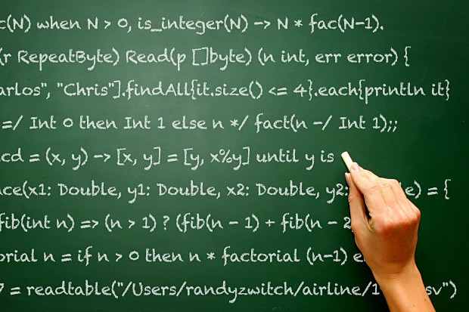
… functional languages?
Erlang, Scala, Haskell, Lisp, etc…
JavaScript
SQL
Notes:
Photo credit : https://www.flickr.com/photos/pong/288491653/in/photolist-ruAw2-6MWqp8-jMHNz2-bwyam-4zaHBg-5GPhty-eestzj-sUGGa-5wLkhi-buSRHk-kMbckP-5vkrNG-NmzF8-b9JXAB-41x2VZ-7QM9Nq-4DZsap-ffqsLr-h7hioW-9NENXp-5QTyo3-etWrxK-aM49tH-brBma1-aFh4bj-bsSHtw-bUqWdg-mKo7vt-6qFQHM-mgL3J-sTrR-aV2peB-4UNKGG-2w5zX-eX8Ep2-9ssVZH-83xwm3-8Wi41s-4QDvdx-6ByYYg-6uK4KW-5jdeXU-e8KumD-abEKw8-3yigw-fMWQEe-ZepPP-gaRCV5-2aSqKR-77A6oM/

Slide 4
How does F# fit?
Functional Language for .NET
Compiled to MSIL, run on .NET
Access to all .NET libs, can interact with C# and VB.NET
Notes:
Photo credit : https://www.flickr.com/photos/pong/288491653/in/photolist-ruAw2-6MWqp8-jMHNz2-bwyam-4zaHBg-5GPhty-eestzj-sUGGa-5wLkhi-buSRHk-kMbckP-5vkrNG-NmzF8-b9JXAB-41x2VZ-7QM9Nq-4DZsap-ffqsLr-h7hioW-9NENXp-5QTyo3-etWrxK-aM49tH-brBma1-aFh4bj-bsSHtw-bUqWdg-mKo7vt-6qFQHM-mgL3J-sTrR-aV2peB-4UNKGG-2w5zX-eX8Ep2-9ssVZH-83xwm3-8Wi41s-4QDvdx-6ByYYg-6uK4KW-5jdeXU-e8KumD-abEKw8-3yigw-fMWQEe-ZepPP-gaRCV5-2aSqKR-77A6oM/

Slide 5
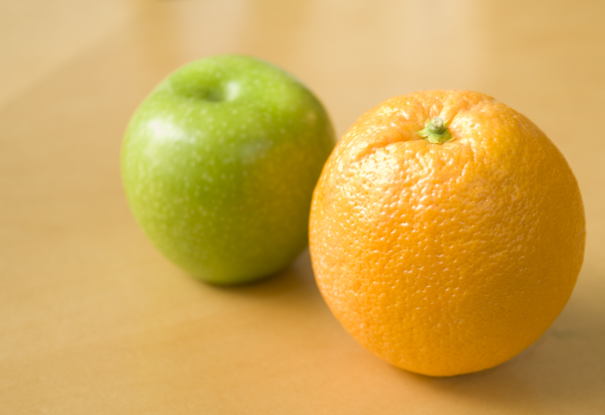
Values == Functions
Notes:
https://www.flickr.com/photos/thebusybrain/2492945625/in/photolist-4NhZT8-8U6tx-cvhKt5-hmjsDR-9Aoswy-5LaoaK-d4SY4j-5VKByX-kc4YDa-tCdKmi-6stQ3u-7SyrE-hGLn1N-fKF5as-5pqV9-5XNXUp-6QWc7V-bscqLn-kH8bDg-8iBRZ8-oWhMGU-h7sEyG-6RVokc-5W8ZC4-2WNRBN-J21kD-rix6Vu-4zqSe6-75jhtm-mbGscn-rwPy8-5DiJVM-mAyDCx-8UykdQ-4tuZf7-8399WK-fnJR3z-4xZbQe-4FEjuk-5gq8WN-4UarHF-8bHVH9-5FHwg9-e6hVY4-8KgmfD-b3UuSc-fom15q-ahqDzf-776ozC-dvhQgt

Slide 6
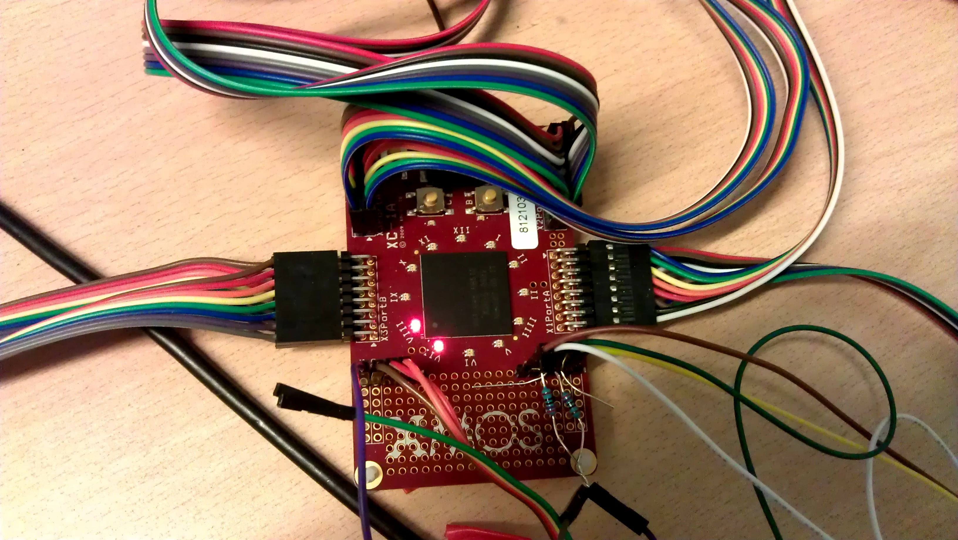
Let the compiler do it’s job
Notes:
https://www.flickr.com/photos/embecosm/8079712912/in/photolist-diYDa3-diYD1j-diYCRJ-diYEPn-diYEJ2-diYEAk-egeG5N-54eDas-54eD7Q-54eD5Q-54eD3S-54apsP-4J1er4-4J1eqV-4J1era-4J1er6-4J1er2-bGtofH-efJhmx-diYEtx-edqyur-4vhtTz-j5sC2H-8gMpmZ-6QYTKP-27G2f4-5dikgj-6MG76U-cb8mDC-r2RxJj-duXvXG-8uDKdF-63ma9D-djQdZg-bU2Cer-hQsokC-boAeym-4mnwgW-5T5ZM-pqdcoQ-pEw7tW-pqbhTZ-8qa6aT-9RfBze-56GYok-5Lsko5-8RVTS-hDQMfj-ascNkb-4ME9Dx

Slide 7
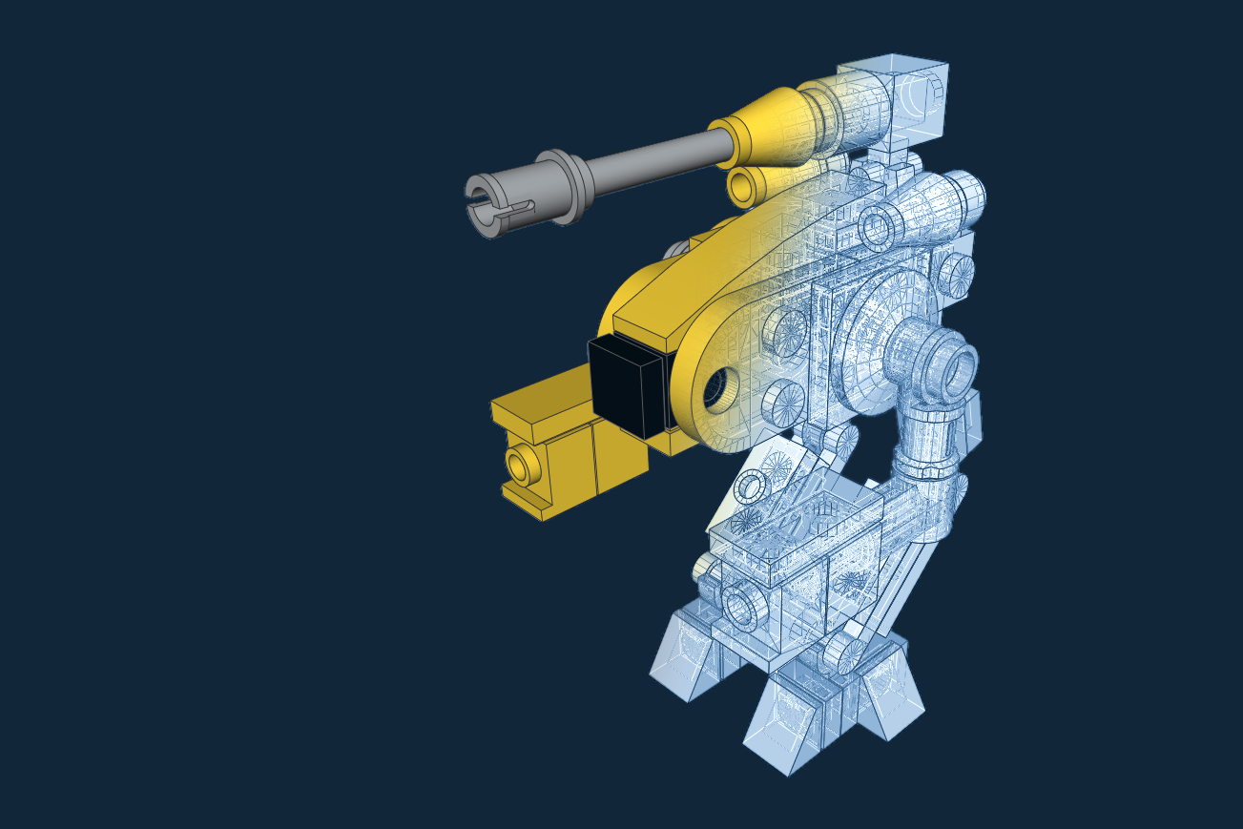
Describe what you want
Notes:
https://www.flickr.com/photos/pasukaru76/6834214622/in/photolist-bpV8UA-68c8dQ-6K9jb8-39bWFB-4mbNmG-4Cryx-2aRBU9-c2mfZu-7RVQRi-8desRa-ntKGaS-8ZxBba-7AbLTM-dMTqW3-4866mH-rjNaZL-9hYhWK-7MP9RU-dexZ3L-6K9jpH-6K9jC4-dhfQ5N-rfCB9g-r5vEd9-nBshnQ-5WoP4f-Ftxe-jB4t16-7vS6fV-dtEmrp-9KsFUo-9KpQVF-9KpQMz-4m7NmB-qqiNK6-bMLUPp-qY4LbS-nkFqB2-7Xn7f-q1prK-87asnj-84R7FU-sepy36-4mbHVY-5qgm94-5WjwED-5WoP4N-biVihz-rhsh7A-hVCY8u

Slide 8

Immutable by default
Notes:
https://www.flickr.com/photos/irwin-scott/5693318647/in/photolist-9F6Khk-d9Hiqb-d9HAtA-d9Hidf-6HemLw-rK4kKi-nQqA7z-sb9tjp-bzLXmb-5GeTGF-4de82k-nQqArH-sb9tf6-d9Hf6k-5Eq5jV-d9HzRF-pAmV6t-d9HxjE-gknrJp-otX9se-bDWRpP-8ksiYL-d9Htwr-ecVQRj-d9HsAd-9eWEop-h5jcE-6Ha9tK-8AaLU-7X33ct-d9HdEv-9sR36Q-9sN3mv-bzLTDE-bA2pjW-pS523b-bNW3AK-p9dDH7-725Wua-d9HmSC-729W5C-qL9hJ1-ehMAR7-idCLHo-ehWBXz-6Sf1KS-ecQbYX-oCdZUj-7p8ERP-osUFoc

Slide 9

Lazy Evaluation
Notes:
https://www.flickr.com/photos/torek/2467519466/in/photolist-4L3Fz5-pdyndn-fuWfDm-8ZW9Xy-naJVwt-aC287b-dVrVE2-oh6v3z-dQHZgY-5eV6iN-8ksZ3h-aiPSiT-f6fG7Y-oNNxYp-9k1yWR-fm1Fi-qo1bBp-5hAK2a-28ZDjA-99YMwr-dxHzDw-4aKMZZ-gBDqht-6L6B7f-rCJi3T-5aMXmG-auxDD3-peX1Ys-egFCWn-dX4xLH-qHA3ur-hujS3Q-i8TwDF-8nQ8wt-myozEy-hvECij-78G15f-5w7mht-4Rtn2A-jBgTWY-99bb2c-5v8bik-oiZ9XB-duAe9-jBj1R-4E2s7M-9gbWui-A2dP1-bxfKC-oQ1Bij

Slide 10

Where OOP just doesn’t cut it…
Notes:
https://www.flickr.com/photos/nofilm/8356116472/in/photolist-dJphiE-t9hUo-t9i2k-9WZV-8wQpzH-342deq-6onAmt-6KJGuV-4JBSuE-66Uk8-4wdjMH-7xhy92-8nfz4w-6r43iy-qL3HN-PJNRX-7amfP7-8nengi-fnUo6R-8NAvXX-m6EZa-935Bby-8NAwF8-8NAwtT-8NAwgV-8NDBNA-8NAvJZ-8cQ6Ti-9v27nY-a7LNWv-8p3kpw-2oCD7-4g9qN3-fe8s1A-4ycrh5-7vgMzN-7LTHqA-o8rkrx-5eoDQ8-9uY6xn-gMkaX-9v2699-8MCUGP-4udWQT-4uhZgy-3gVdGC-pVBqbF-dXHemW-8Nz87h-LCvnL

Slide 11
DEMO!
Notes:
Photo credit : https://www.flickr.com/photos/pong/288491653/in/photolist-ruAw2-6MWqp8-jMHNz2-bwyam-4zaHBg-5GPhty-eestzj-sUGGa-5wLkhi-buSRHk-kMbckP-5vkrNG-NmzF8-b9JXAB-41x2VZ-7QM9Nq-4DZsap-ffqsLr-h7hioW-9NENXp-5QTyo3-etWrxK-aM49tH-brBma1-aFh4bj-bsSHtw-bUqWdg-mKo7vt-6qFQHM-mgL3J-sTrR-aV2peB-4UNKGG-2w5zX-eX8Ep2-9ssVZH-83xwm3-8Wi41s-4QDvdx-6ByYYg-6uK4KW-5jdeXU-e8KumD-abEKw8-3yigw-fMWQEe-ZepPP-gaRCV5-2aSqKR-77A6oM/

Slide 12
F# Resources
https://github.com/ChrisMarinos/FSharpKoans
http://fsharp.org/about/learning.html
http://fsharpforfunandprofit.com/
Notes:
Photo credit : https://www.flickr.com/photos/pong/288491653/in/photolist-ruAw2-6MWqp8-jMHNz2-bwyam-4zaHBg-5GPhty-eestzj-sUGGa-5wLkhi-buSRHk-kMbckP-5vkrNG-NmzF8-b9JXAB-41x2VZ-7QM9Nq-4DZsap-ffqsLr-h7hioW-9NENXp-5QTyo3-etWrxK-aM49tH-brBma1-aFh4bj-bsSHtw-bUqWdg-mKo7vt-6qFQHM-mgL3J-sTrR-aV2peB-4UNKGG-2w5zX-eX8Ep2-9ssVZH-83xwm3-8Wi41s-4QDvdx-6ByYYg-6uK4KW-5jdeXU-e8KumD-abEKw8-3yigw-fMWQEe-ZepPP-gaRCV5-2aSqKR-77A6oM/

Slide 13

Thank you!
www.JamesCBender.com
github.com/JamesBender
james@jamescbender.com
Twitter: @JamesBender
hallwayconversations.com

